Slide 1
Control System Thoughts
Kay Kasemir
July 2026

Slide 2
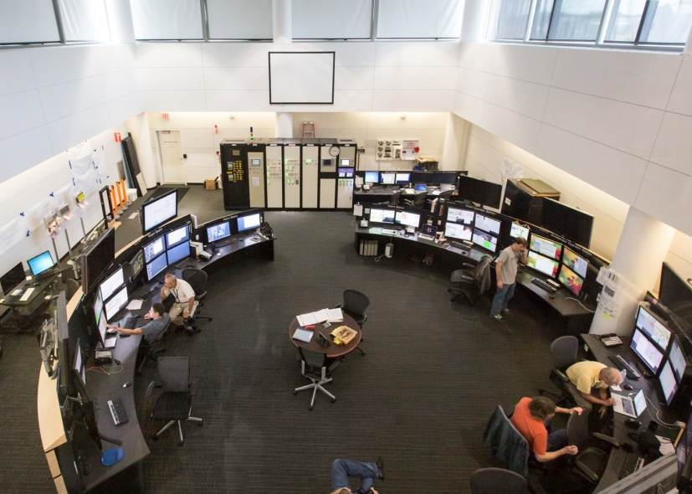
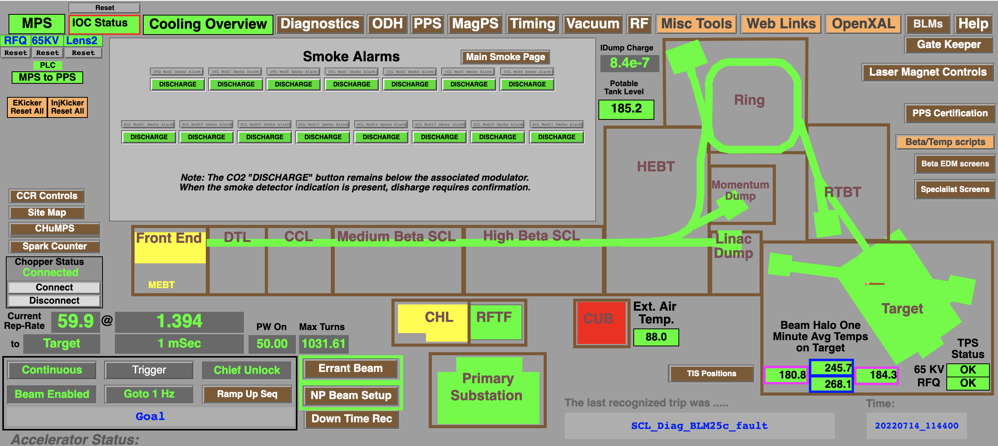
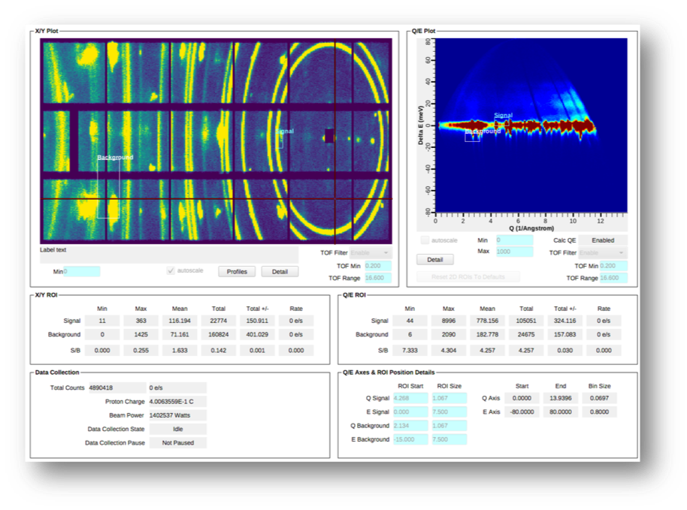
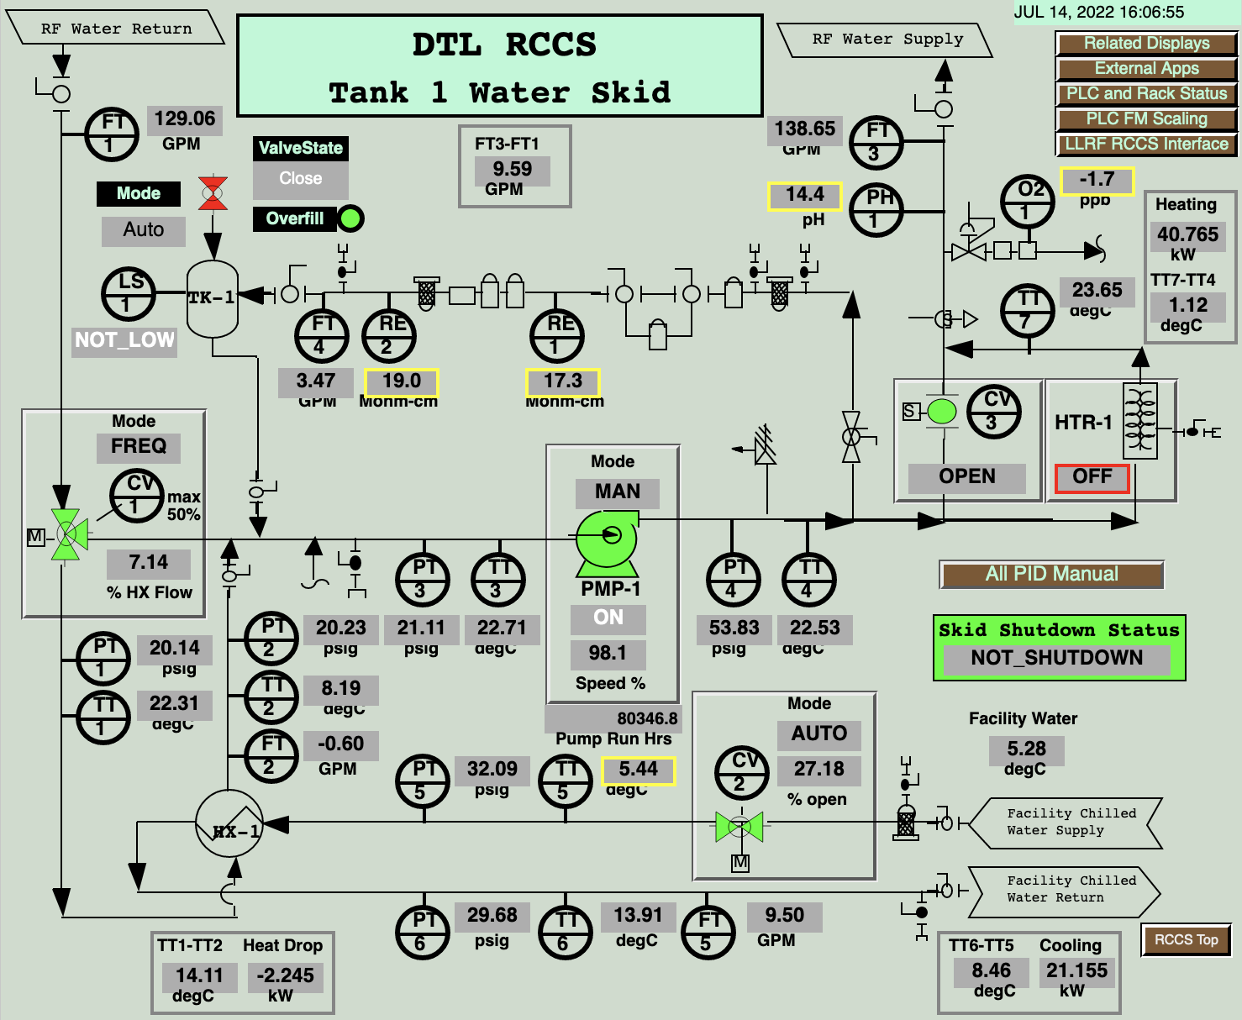
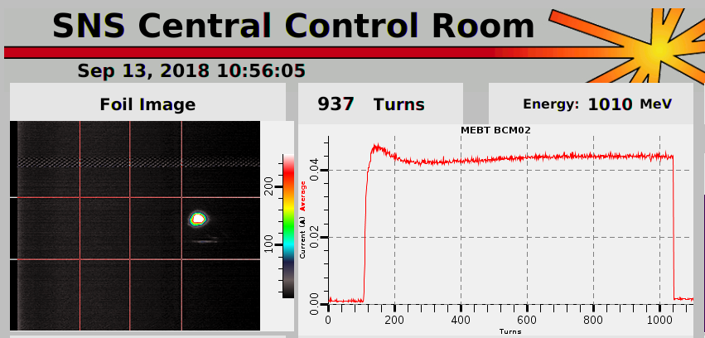
Different Views of the Control System: What you see

Slide 3
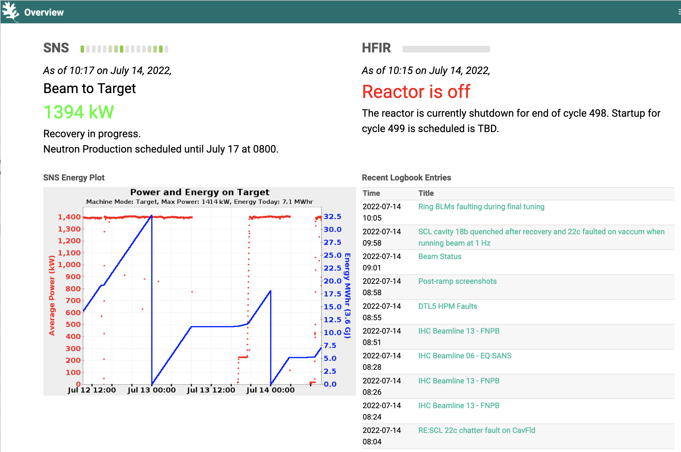

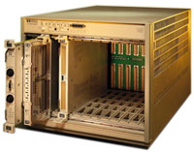
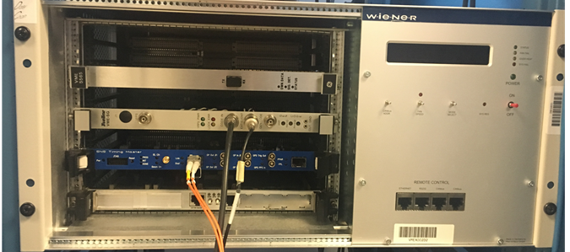
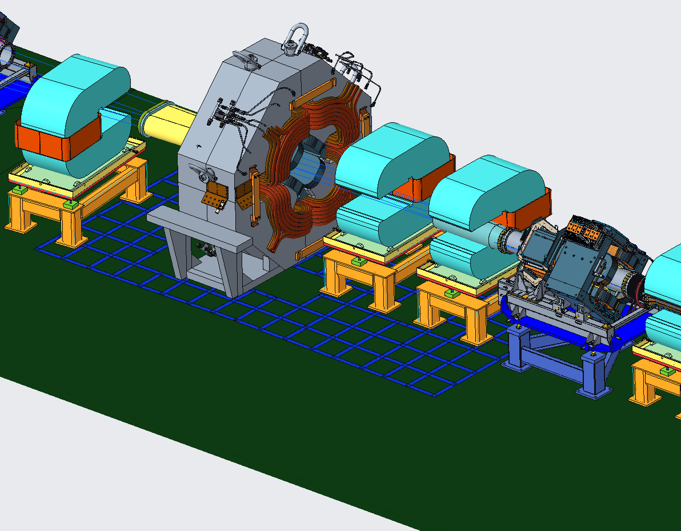
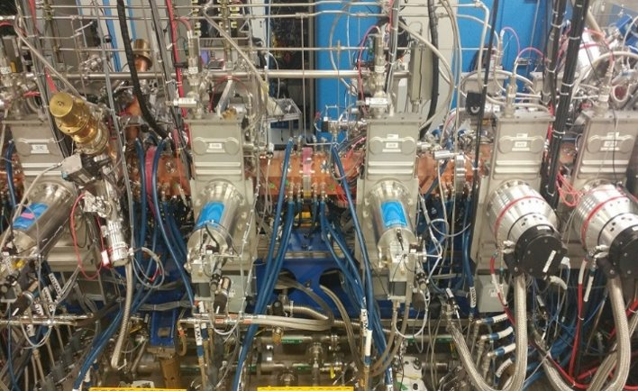
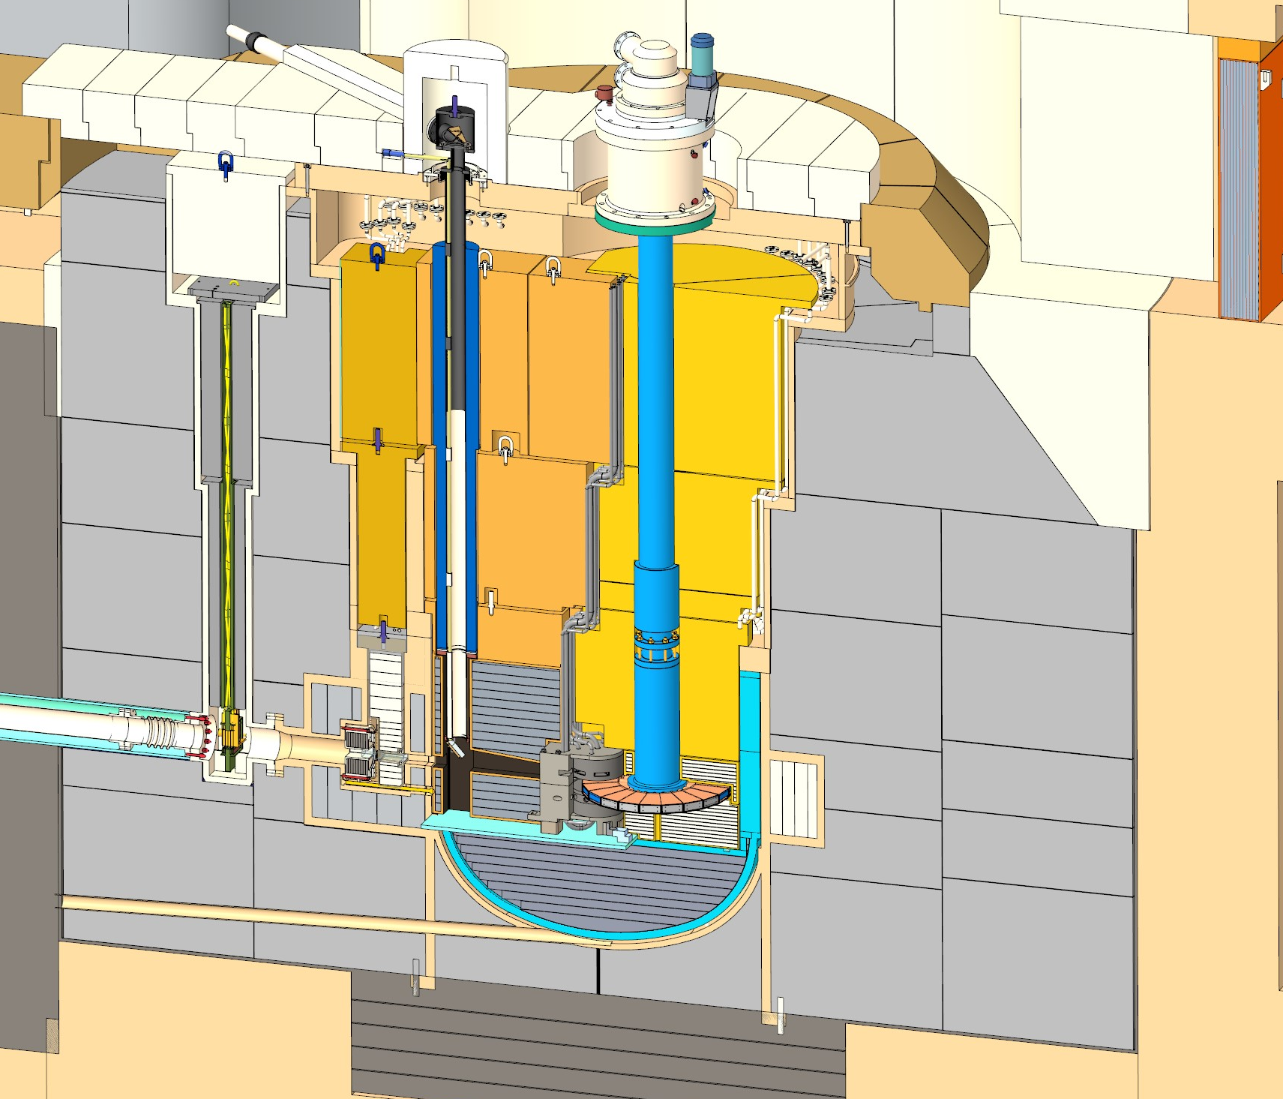
Different Views of the Control System:
Hierarchy of components
Internet
Controls Network
Read-only firewall & gateway
Channel / PV Access
I/O
I/O
I/O

Slide 4
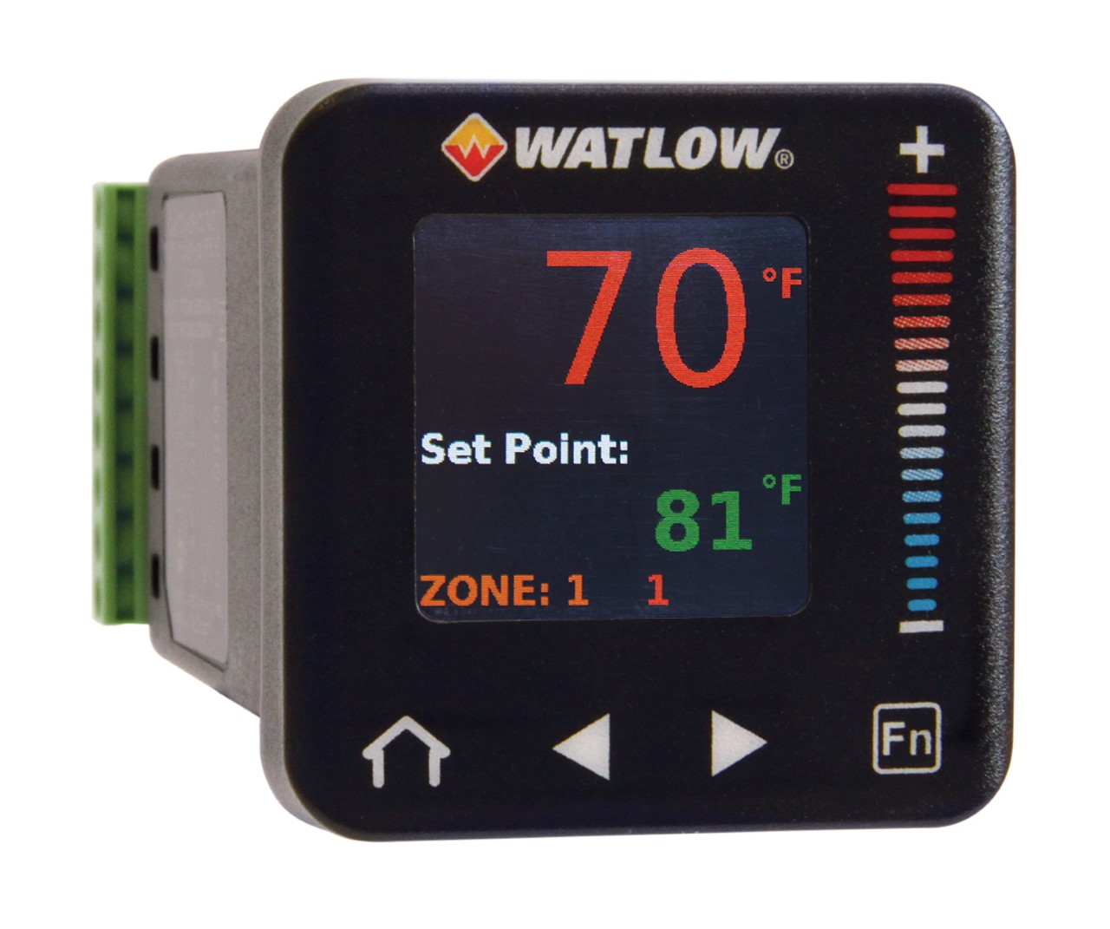
Different Views of the Control System: Managerial
Controls are roughly 5-12 % of the project cost
  Scope:
  Do you buy the Power Supplies or just control them?
  Important but outside of this:
  Work Breakdown Structure, risk registry, cable database, design reviews, building a team with necessary expertise (hire, matrix, contract?), …
Most of controls cost is labor
Most of that labor is spent on handling new devices unique to this project
  EPICS provides the SCADA tools to
  support a large number of commonly used devices. You simply “configure” them.
  EPICS allows adding support for unique, site-specific devices. This will require some “programming”.
$$
Controls
Bob Dalesio, Discussions

Slide 5
Integrated Control Systems
Integrate different types of devices
Industrial controls
Laboratory & scientific devices
Custom hardware

Slide 6
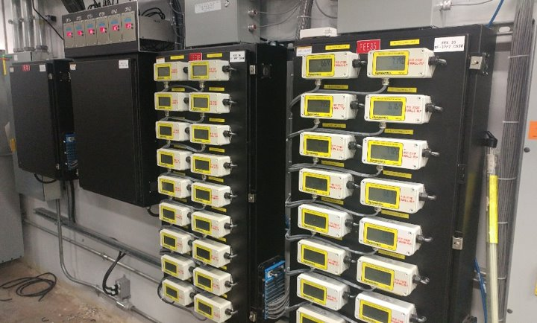
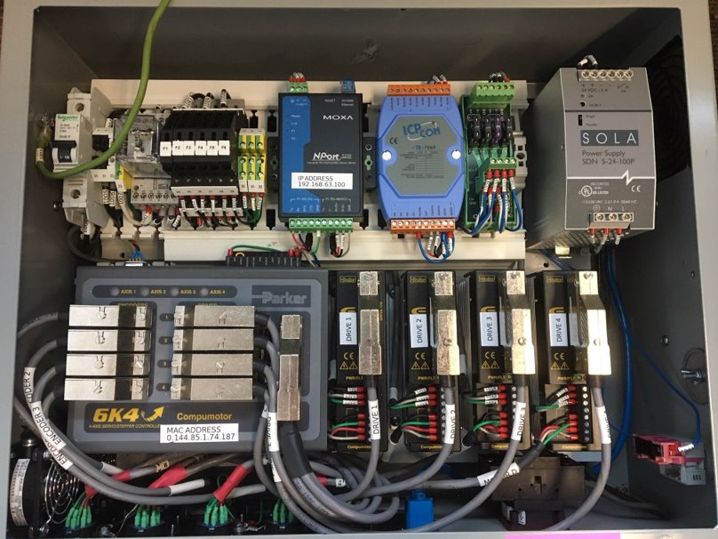
Industrial Controls
COTS sensors and controllers for temperature, flow, pressure, voltage, current, motor speed, position, ..
For vacuum, cooling, PPS, …
Rugged, designed to be panel/rack/rail-mounted
Typically monitored every ~ second
Use reputable brands with track record
Limit the number of variants
Standardize on serial or ethernet interfaces
.. with open, documented protocol
Avoid one-off gadgets that only come with Win95 software

Slide 7
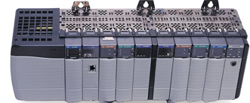
Industrial Controls: PLCs
COTS option for handling a lot of basic I/O
  Low-voltage analog inputs and outputs
  Binary inputs and outputs, low-voltage, 120V relays
  Temperature and flow sensors
  Motor controllers
Can perform control loops and interlocks so IOC only monitors the result
Typically monitored every ~ second
Use established brands with existing EPICS support
Agree on
  Division-of-labor between IOC and PLC
  Suggested arrangement of “tags” for optimized communication with IOC
In several industrial settings, PLCs connected to Panel Views are the control system.
To us, PLCs are intelligent devices but nevertheless just another type of device to integrate into the larger ICS.

Slide 8
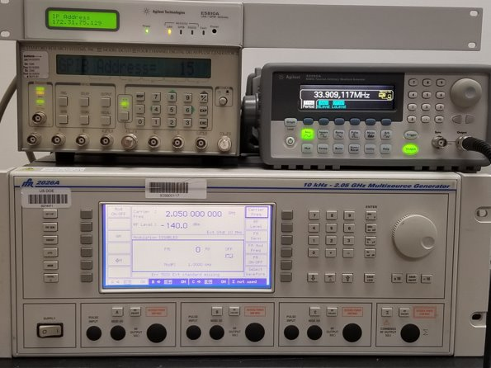
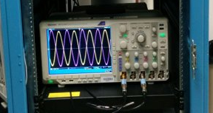
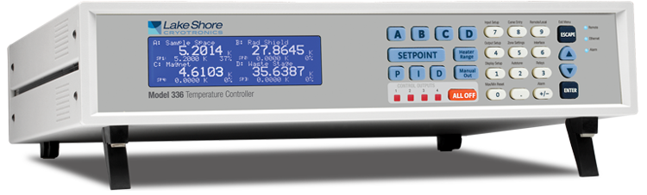
Commercial Laboratory & Scientific Devices
COTS waveform generators, frequency/trigger/delay generators, intelligent power supplies, temperature controllers, coordinated motor controllers, digital storage oscilloscopes, spectrum analyzers, gas analyzers, ..
For LLRF, timing system, neutron detectors, cryostats and other sample environment, ..
Highly accurate, more options than industrial controls
Internally operating at kHz, MHz or GHz rates, with status monitored every ~ second via control system
Often meant for benchtop laboratory usage.
Harder to rack-mount, less robust, less reliable 24/7/365.
Use reputable brands with track record
  HP → Agilent → Keysight → …
Limit the number of variants
Standardize on serial or ethernet interfaces
.. with open, documented protocol
Avoid one-off gadgets that only come with Win95 software

Slide 9
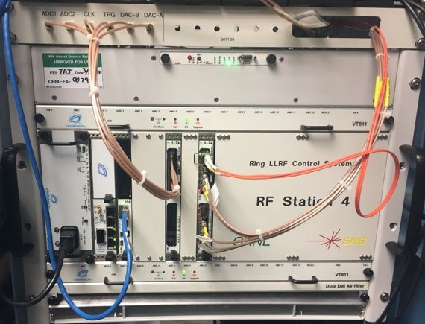
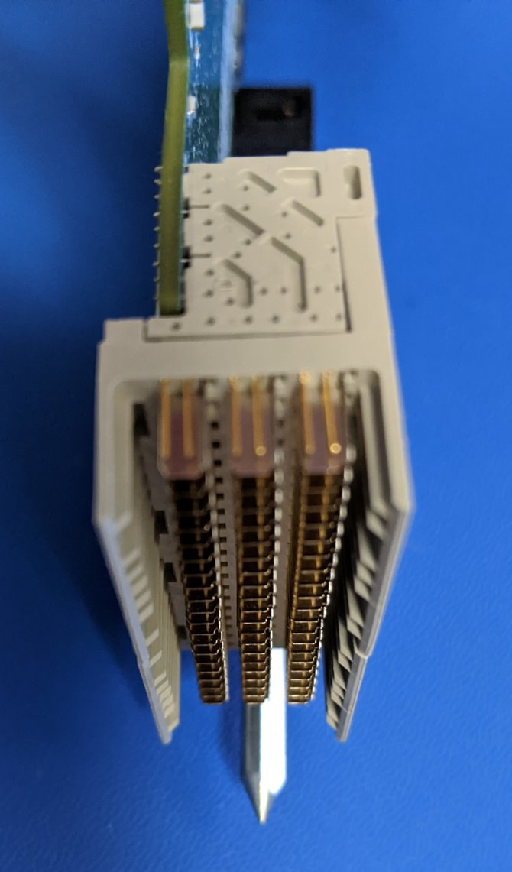
Custom aka High-Performance Hardware
Timing system, LLRF, MPS, beam diagnostics, neutron detectors have unique requirements not met by COTS devices
  Exact timing down to nanoseconds
  Control loops and interlocks that can only be implemented in FPGA hardware
  Monitor status every ~second,
  but “stream” for example 10 million neutron events per sec.
Need to design, develop, implement,
then maintain hardware, FPGA firmware, software
  For ~100 LLRF systems, not 1.2 billion iPhones
  No bulk order discount for us!
Electronic components tend to be obsolete as soon as first devices are installed
Standardize on a few architectures
  SNS started with VME, now focusing on µTCA
Limit the number of FPGA variants (‘Xilinx’)
and firmware languages (‘VHDL’)
Re-use designs of timing receiver in LLRF, MPS, Beam Power Limiting System, …

Slide 10
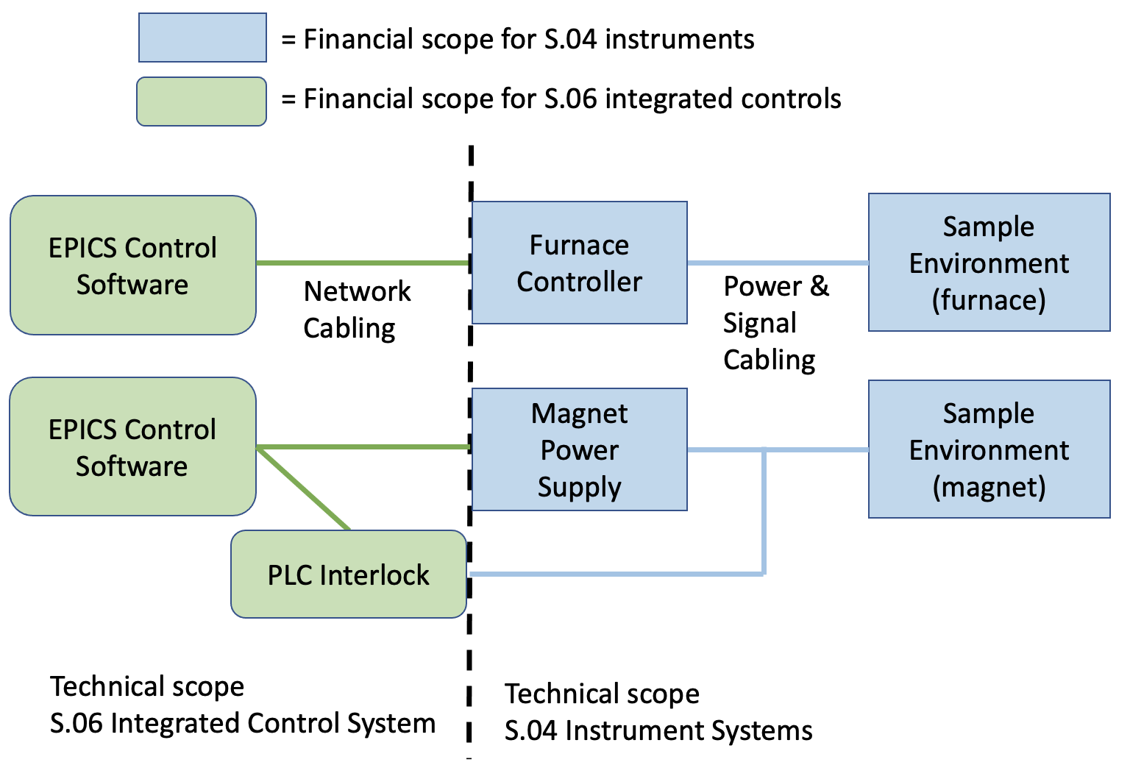
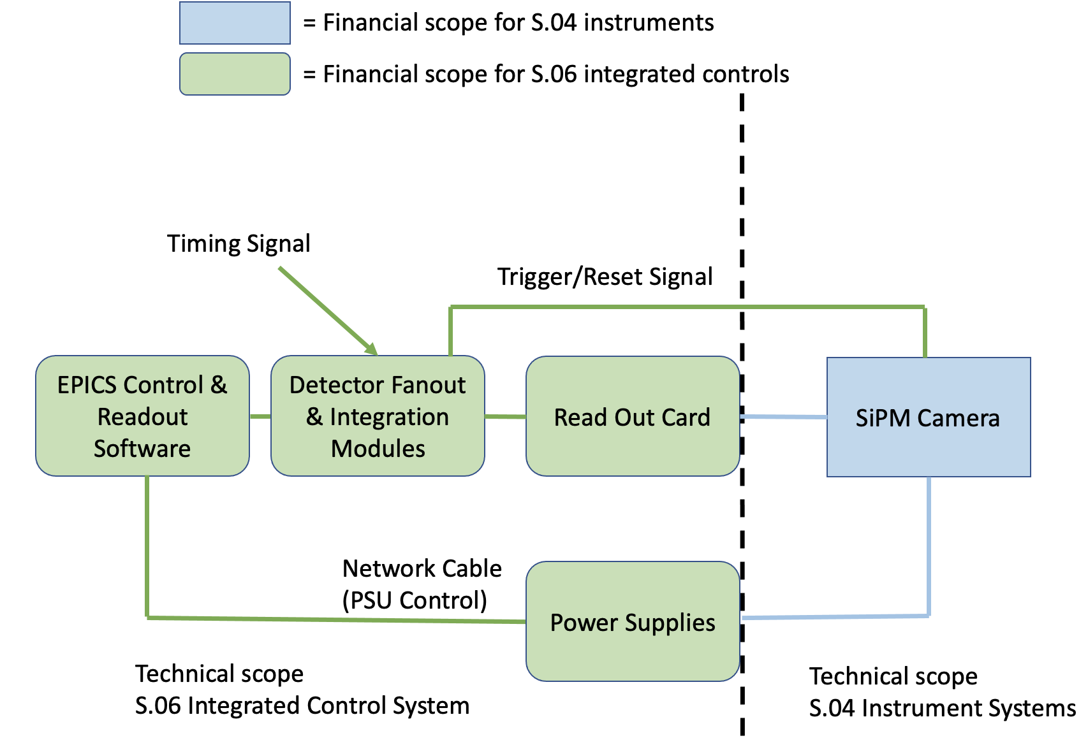
Interfaces
Who provides the sensor, motor, controller, ... ?
  Does Power Supply go with device or with controls?
  Who runs the cables?
Case-by-case agreement
Matt Pearson, STS interface sheets

Slide 11
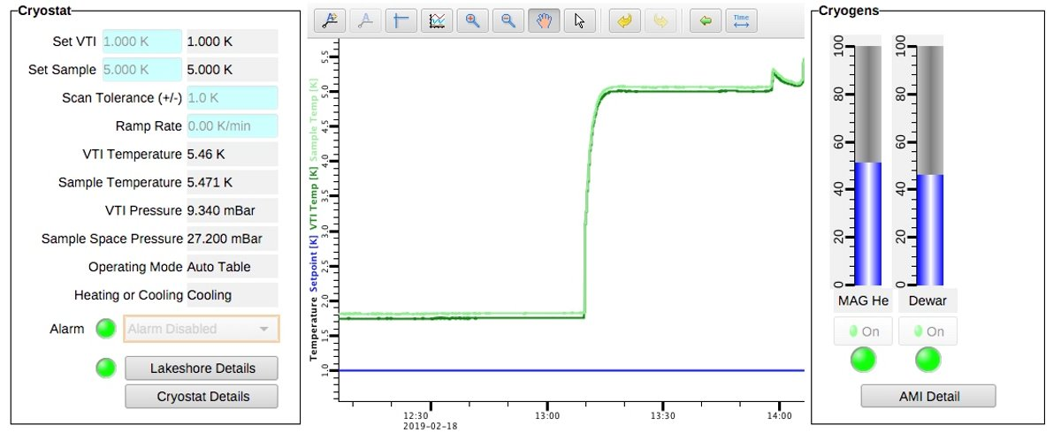
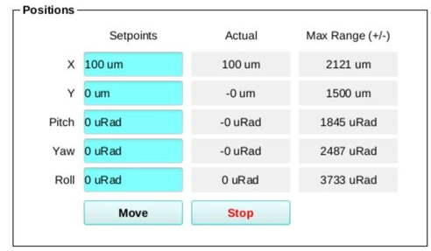

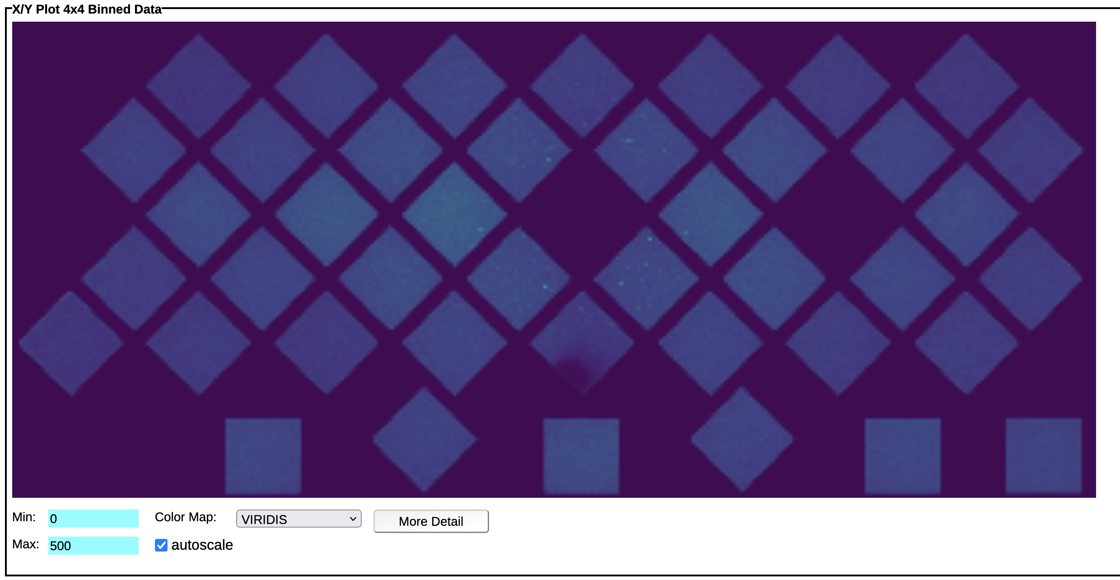
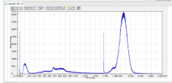
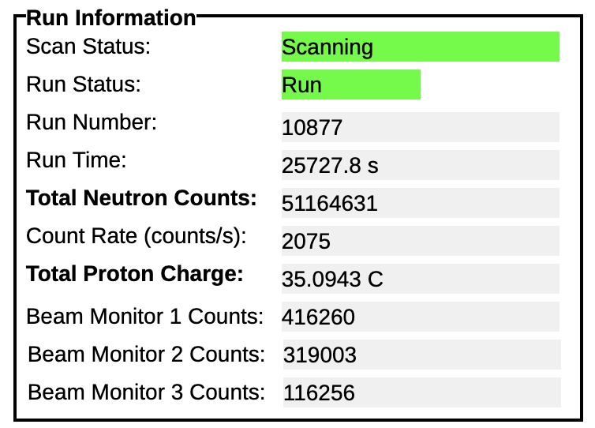
Integration for an Experiment
Industrial & Lab devices
  Motors
  Cryostat
Custom Hardware
  Detector readouts,
  ‘raw’ position and
  d-space, q-space, …
  Data acquisition status

Slide 12
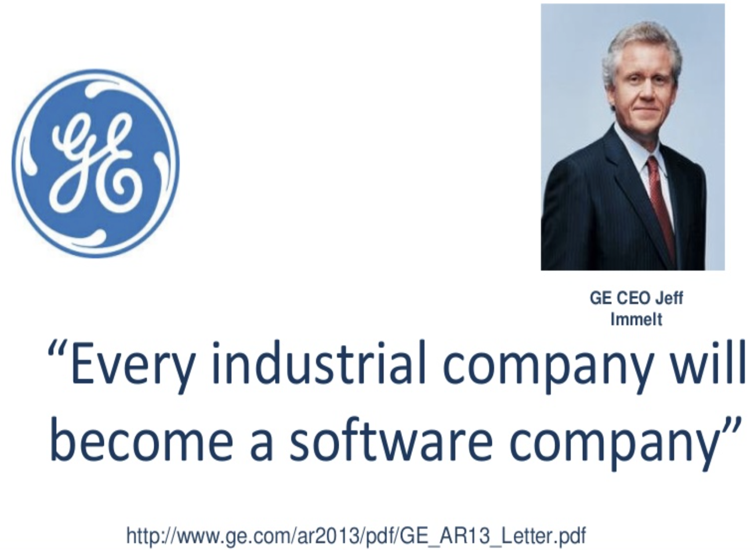
This involves a lot of Software…
.. but GE is still trying to figure out how to be successful as a software company…

Slide 13
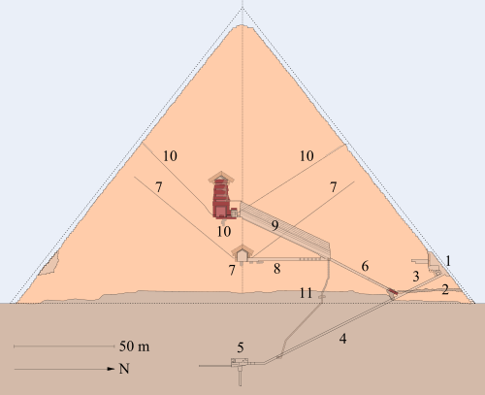
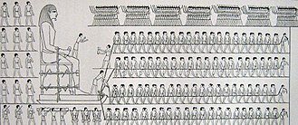

Software is different!
Since forever:
Collect Requirements
  Single person resting place,
  Additional storage,
  Huge!
Design
Build, build,…
Done!
Software:
Limited Requirements
Make the gadget that we’re about to build work
Design, implement, rethink, implement, …
Deploy
New requirements → 1.
Involve ICS in the design process, avoid “build and then add software”
https://en.wikipedia.org/wiki/Egyptian_pyramids

Slide 14
Requirements are hard
Controls: “Do the Beam Position Monitors
need to be correlated?”
Physics: “No”
  Thinking: No need for exact correlation.
  35 µs will be good enough
Controls: “OK”
  Thinking: No need for timing system.
  Let’s read them at 1 Hz
Bob Dalesio, Discussions

Slide 15
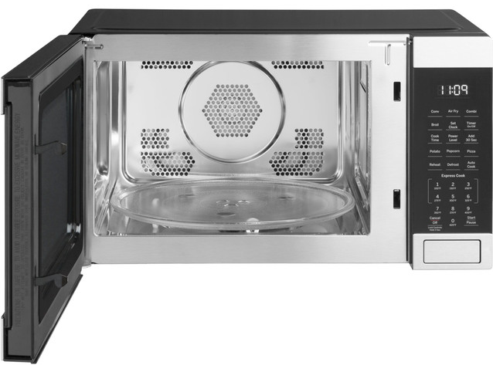
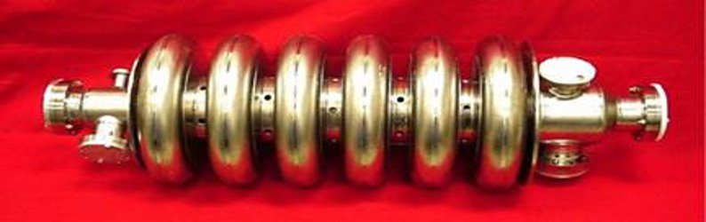
Control System is expected to be flexible and fill gaps in System Engineering
Early SNS requirements example:
1) Turn cavity RF on @ 60Hz to accelerate beam.
2) Any cavity RF off? → Stop beam!
Implemented in LLRF and MPS hardware/firmware to be fast and reliable
.. then physics & ops decided accelerator much easier to tune up if we “coast” beam through idle cavities, but don’t turn cavities off for long because that changes heat loads
1) Turn RF off just for beam pulses
2) In spite of RF being off, allow beam!!
Add ”beam blanking” to software and firmware:
Run RF @ 60 Hz except for on-demand beam pulses,
suppress the RF-off-error, …

Slide 16
Won’t we soon have AI create the control system?
AI is likely to become “a highly capable assistant”
AI can create software, given the proper Prompt
Prompt = Requirements
Requirements are still hard to get…

Slide 17
How can Control System Software ..
Support many types of devices?
Be well tested by many people?
Be flexible?
Plan for longevity?
Don’t do it all by yourself. Share software with others
Use open-source, so (time permitting) you can add/fix anything
Distributed design allows independent addition/removal/update of components
Apply saved time to the collaboration

Slide 18

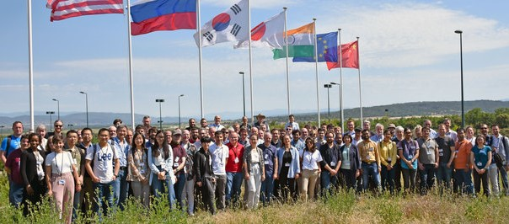
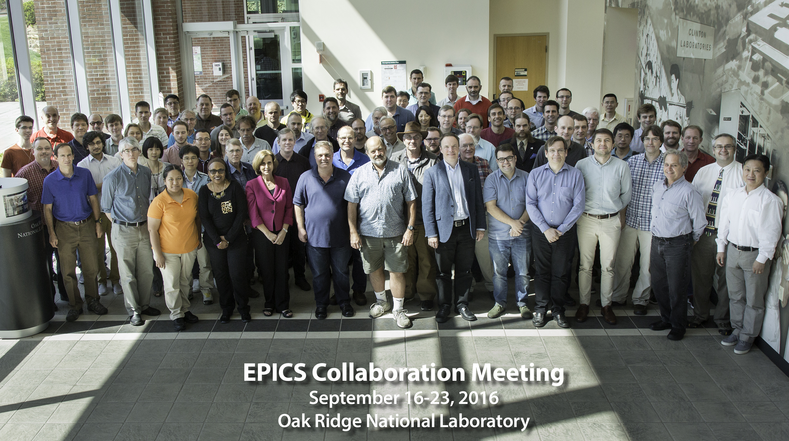
Open-Source Toolkit
Not tied to any vendor
We can see everything and if necessary, fix or adjust
Distributed
Independently add/remove/upgrade components
Collaboration
Started ~30 years ago at Argonne and Los Alamos National Labs
For software, that is outstanding longevity
Used by many accelerator and astronomy sites world-wide
”Has anybody interfaced the XYZ gadget?”
- “Yes, here you go” or
“Well, the older version.
Maybe you can start with that?”
“We have a problem” – “We saw that, too,
and fixed it by …”
2019 @ ITER

Slide 19
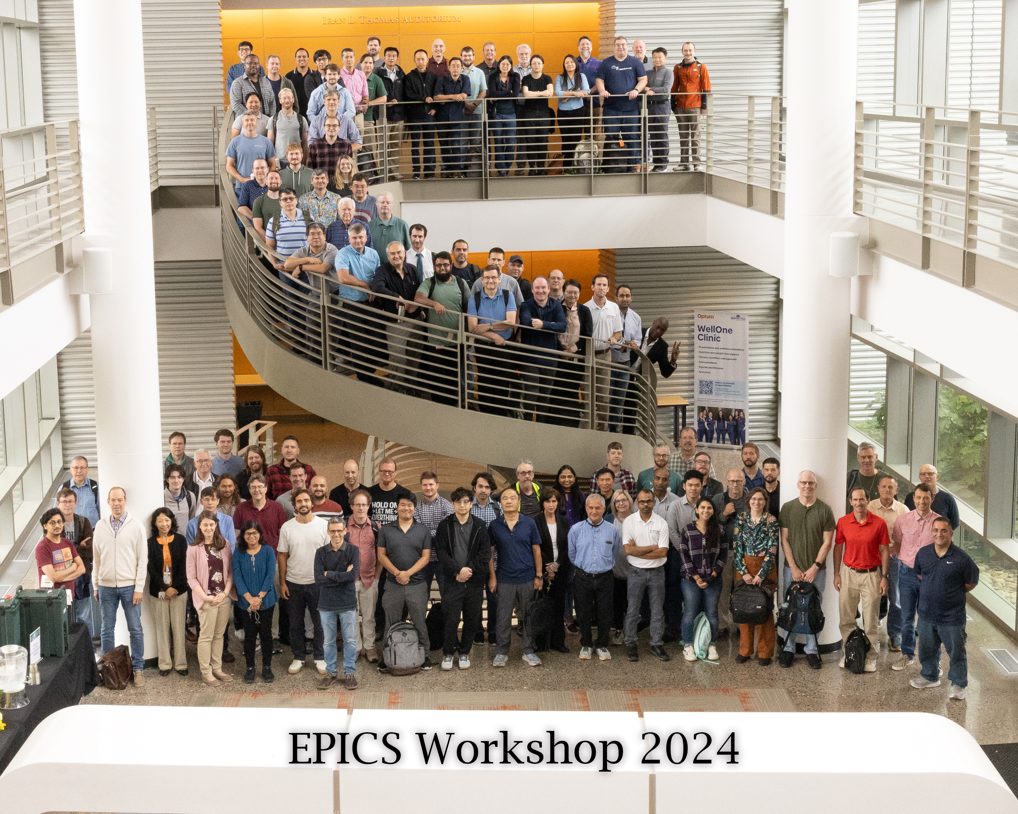
Control Systems Summary
Control system is about Integration
  Industrial, laboratory/science and custom devices
Collaboration
and Standardization
  Improve longevity
@ ORNL

